Slide 1
Digital Portfolio
STUDENT NAME: DHARANEESH S
REGISTER NO AND NMID: 2428D0013 & 56E51DAF9B8D4E6A8B945AB19BF3F868
DEPARTMENT: B.Sc Computer science and applications
COLLEGE: VET INSTITUTE OF ARTS AND SCIENCE (CO-Education)COLLEGE / BARATHIAR UNIVERSITY.

Slide 2
RESPONSIVE PERSONAL PORTFOLIO WEBSITE Dharaneesh S Portfolio
PROJECT TITLE

Slide 3


AGENDA
Problem Statement
Project Overview
End Users
Tools and Technologies
Portfolio design and Layout
Features and Functionality
Results and Screenshots
Conclusion
Github Link
3/21/2024 Annual Review

Slide 4

PROBLEM STATEMENT Many students and professionals lack a digital space to showcase their skills, projects, and achievements effectively. Traditional resumes are static and cannot reflect creativity or adaptability.

Slide 5

PROJECT OVERVIEW This project is about developing a Responsive Portfolio Website that works seamlessly across devices (desktop, tablet, and mobile). It highlights personal details, skills, projects, and achievements in an interactive way.

Slide 6
Students & graduates
Job recruiters
Companies seeking interns or employees
General public interested in profile
WHO ARE THE END USERS?

Slide 7

TOOLS AND TECHNIQUES
HTML, CSS, JavaScript
Bootstrap / Tailwind CSS for responsive design
GitHub Pages for hosting

Slide 8
PORTFOLIO DESIGN AND LAYOUT
Clean, modern, and responsive design
Sections: About Me, Skills, Projects, Contact
Interactive navigation with smooth scrolling
8

Slide 9
FEATURES AND FUNCTIONALITY
Mobile-friendly responsive interface
Project showcase with images/screenshots
Contact form / links to email & social media
Easy navigation
GITHUB LINK: https://github.com/dharaneesh20834/Dharaneesh-TNSDC-SDP-PWD.git

Slide 10
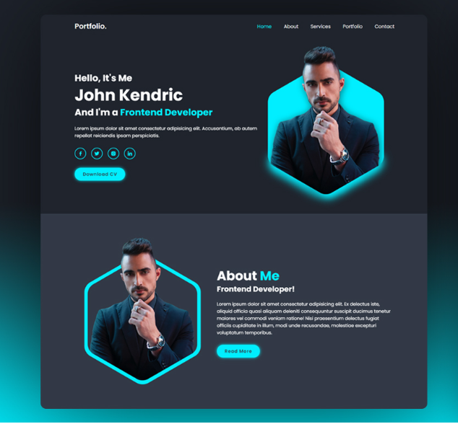

RESULTS AND SCREENSHOTS
The Responsive Portfolio Website was successfully developed and deployed. It provides a clean and attractive interface where personal details, academic information, and projects are displayed in a well-structured manner. The website adapts perfectly to different screen sizes, ensuring smooth access on mobiles, tablets, and desktops. Navigation is user-friendly, and all key sections such as About, Skills, Projects, and Contact work as intended. This enhances visibility and makes it easier for recruiters and peers to learn about my skills and achievements.
3/21/2024 Annual Review
10

Slide 11
CONCLUSION
The Responsive Portfolio Website serves as a personal digital portfolio, helping to present skills, academic achievements, and projects in a professional manner. It improves online presence and employability.
11

